Slide 1
MGMTMFE 412 · TRADING, MARKET FRICTIONS & FINTECH
Lead-Lag Trading in the
AI Ecosystem
Intraday repricing hierarchy across AI hardware and software stocks
NVDA → AMD · MSFT · GOOGL | control: AAPL
1 Introduction
2 Data & Methodology
3 Results
4 Risk Discussion
5 Conclusion
UCLA Anderson School of Management · Spring 2026 · Group 1, Cohort 1

Slide 2





1 · INTRODUCTION
Sequential repricing of correlated AI assets
NVDA is the primary price-discovery vehicle for AI sentiment. When AI-specific flow hits the most-watched name, independent market makers in peer stocks update their quotes only once order flow arrives in their own books — 15 to 60 seconds later. That delay is a tradeable friction.
AAPL as the macro filter
NVDA moves, AAPL flat
→ AI-specific signal — the lag holds. Trade it.
NVDA & AAPL move together
→ broad macro move (rates, data, risk-on/off). Skip it.
AMD
MSFT
GOOGL
NVDA
20s lag
45s lag
30s lag
Leader
AAPL is mega-cap hardware with minimal AI-infrastructure exposure — the ideal control.
2

Slide 3



1 · INTRODUCTION — The trade in one slide
A market-neutral repricing trade
When NVDA moves decisively and AAPL is flat, go long the lagger and short NVDA dollar-neutral to isolate pure repricing alpha. Hold for the lagger's documented horizon, then close.
01
02
03
04
Detect
Confirm
Enter
Exit
NVDA microprice moves > threshold over 15s and AAPL stays flat (< 3 bps).
Lagger OFI neutral and microprice flat — repricing hasn't started yet.
Long 100 sh lagger + short NVDA in dollar-neutral proportion.
Close after the lagger-specific hold window (30–60s).
Net market exposure ≈ 0. The dollar-neutral NVDA short hedges out the broad move; what remains is the lag.
3

Slide 4


2 · DATA & METHODOLOGY — a. Data
MBP-10 order book, 5 symbols, 25 days
5
10
~585K
15 / 10
symbols
depth levels
rows
train / test days
NVDA · AMD · MSFT · GOOGL · AAPL
MBP-10 Level-2 order book
4,680 bars/symbol/day · 5s bars
no test data in calibration
Synthetic L2 today, Databento-ready
Stoikov microprice as reference price
Data calibrated to documented AI-ecosystem lags, realistic 0.7–1.5 bps mega-cap spreads, and reasonable book depth.
Pipeline is data-source agnostic — signals, transaction costs, and backtest engine swap directly onto Databento MBP-10 parquet for production.
micro = (bid_sz·ask_px + ask_sz·bid_px) / (bid_sz + ask_sz)
Embeds queue imbalance: a thicker bid pushes the microprice toward the ask, predicting upward pressure before the mid moves.
4

Slide 5



2 · DATA & METHODOLOGY — b. Signal Construction
Fire on the leader, gate on the lagger
Entry logic
Per-lagger entry thresholds
NVDA trigger
Calibrated to each lagger's gross-edge profile — weaker followers require a bigger NVDA move so expected edge clears round-trip cost.
Microprice moves > 7 bps over a 15s window (3 × 5s bars).
Macro filter
AMD
7.0 bps
AAPL must be flat (< 3 bps), else flag as broad move and skip.
multiplier ×1.0
OFI gate
MSFT
7.7 bps
Cont–Kukanov–Stoikov OFI on the lagger must be neutral — if it already shows flow in NVDA's direction, repricing has begun.
multiplier ×1.1
Freshness gate
GOOGL
11.2 bps
Lagger microprice must still be flat. Enter only when both gates pass.
multiplier ×1.6
GOOGL has the weakest follow strength — the ×1.6 threshold filters for high-conviction signals only.
5

Slide 6

2 · DATA & METHODOLOGY — c. Execution & Transaction Costs
Walk-the-book costs, per-lagger holds
Walk-the-book transaction costs
Per-lagger hold & cooldown windows
Lagger | Hold | Cooldown
AMD | 30s (6 bars) | 50s
MSFT | 50s (10 bars) | 70s
GOOGL | 60s (12 bars) | 80s
Lagger
Hold
Cooldown
Market orders fill against visible depth level by level: best price until size exhausts, then worse. Larger orders pay progressively worse prices — no flat-cost assumption.
$4.06
Uniform holds underestimate slower laggers and cause premature exits that negate the gross edge. Cooldowns are tracked independently per channel — an AMD trade blocks only AMD, while MSFT and GOOGL keep firing.
avg cost per round-trip (test)
Reflects tight mega-cap spreads of ~0.8–1.5 bps at top of book.
6

Slide 7
3 · RESULTS — a. Lag Structure Analysis
The repricing hierarchy is real and ordered
Hardware → hardware is fastest
NVDA leads AMD by ~20s — AI hardware sentiment propagates quickly within the hardware sub-factor.
Hardware → software is slower
MSFT (45s) and GOOGL (30s) lag further, supporting a distinct AI-software repricing channel.
AAPL confirms the control
Zero lag, r = 0.42 — AAPL moves with NVDA on macro flow, never after it. That's why it filters non-AI signals.
Correlations: AMD 0.47 · MSFT 0.35 · GOOGL 0.32 · AAPL 0.42
7

Slide 8
3 · RESULTS — b. Backtest Results
Positive, consistent, out-of-sample
$1,582
63.4%
22.37
-$1.38
test PnL
hit rate
Sharpe (test)
max drawdown
across 235 trades
vs 63.0% in train
construction-consistent
test period
Metric | Train (15d) | Test (10d)
Number of trades | 368 | 235
Total PnL | $1,825.44 | $1,582.41
Hit rate | 63.0% | 63.4%
Sharpe ratio | 15.94 | 22.37
Max drawdown | -$86.48 | -$1.38
Avg TC per trade | $4.02 | $4.06
Test PnL by lagger
MSFT
$1,116.8
86 trades · 64.0%
AMD
$294.08
118 trades · 61.0%
GOOGL
$171.52
31 trades · 71.0%
8

Slide 9
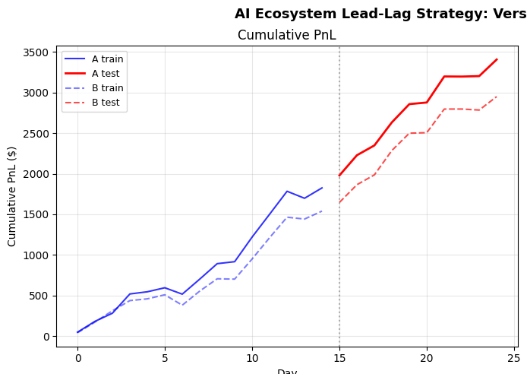
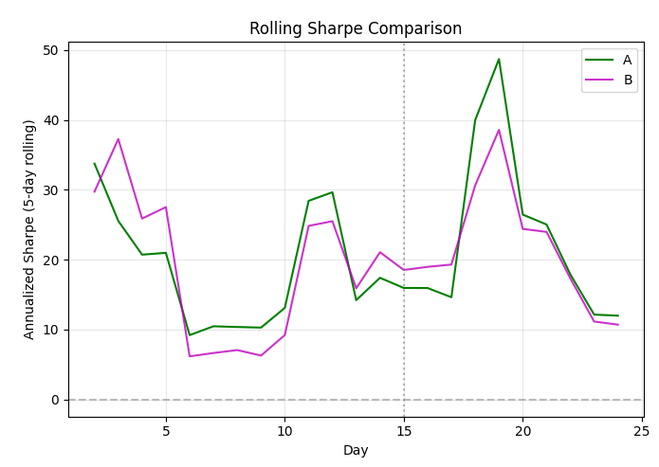
3 · RESULTS — d. Required Plots
Cumulative PnL and Rolling Sharpe
Strategy earns consistently across both train and test. Rolling Sharpe remains positive throughout the out-of-sample window — no extended drawdown periods.
✦ Test PnL (red solid) is monotonically increasing — strategy earns on every test day.
✦ Rolling Sharpe always positive out-of-sample — no regime where the strategy loses direction.
9

Slide 10

3 · RESULTS — b. Backtest Results — robustness
Every leg earns its place
Dropping GOOGL entirely (AMD + MSFT only) is worse on every metric — confirming GOOGL is a positive contributor once correctly calibrated, not a leg to cut.
Full hierarchy
AMD + MSFT only
AMD · MSFT · GOOGL
GOOGL dropped
Test PnL
$1,582.41
Test PnL
$1,410.89
Sharpe
22.37
Sharpe
20.25
Max drawdown
-$1.38
Max drawdown
-$12.55
10

Slide 11
3 · RESULTS — c. Beta & Alpha Decomposition
Beta ≈ 0, alpha is the repricing edge
β = +0.06
market beta
The hedge is working as designed
p = 0.53 — not distinguishable from zero
Daily returns are normalized by the $50,000 per-trade gross notional. The SPX proxy is the equal-weighted daily return of all five stocks in our universe, making the regression dimensionless and beta a standard market beta.
A beta indistinguishable from zero plus a low R² means broad market moves are hedged out. What remains — the +0.32% daily intercept — is the lead-lag repricing alpha.
α = +0.32%
daily alpha
≈ $159/day pure repricing edge
R² = 0.05
explained variance
variance is idiosyncratic to the signal
11

Slide 12
4 · RISK DISCUSSION
What could break the trade
Regime risk
Capacity
Signal depends on NVDA as the AI sentiment leader. A new chip entrant or low AI news flow degrades it.
Negligible impact to ~$100M; material at $1B. Estimated capacity $200M–$500M before impact erodes edge.
Signal decay
Implementation
If others arbitrage the lag, it compresses toward HFT timescales — forcing shorter holds and higher turnover.
Must detect & execute within 5–10s; co-location helps. Monitor rolling correlation & lag continuously.
12

Slide 13
5 · CONCLUSION
The AI hierarchy shows up in the order book
NVDA reliably leads AMD (~20s) and MSFT/GOOGL (30–45s); hardware-to-hardware repricing is measurably faster than hardware-to-software.
Per-lagger calibration of thresholds, holds, and cooldowns extracts edge from each leg independently rather than a single global parameterization.
Result on test: market-neutral, 63.4% hit rate, β ≈ 0.06, max drawdown -$1.38, $1,582 PnL over 235 trades.
Next step: Synthetic data caps realism — production on Databento MBP-10 will test whether the lag holds in live books and whether Sharpe lands in the typical 1.5–3.0 intraday range.
13

